Slide 1

Research Project WS 22/23
Arnova Abdullah
Weekly Meeting – 01.02.2023

Slide 2

Previous Weeks Meeting Details
Week 1 Meeting (19.10.2022)
Basics about Radio Access Network (History, parts of RAN for 1G, 2G, 3G, 4G)
Basics about Open RAN (Distribution unit, central unit, user plane, control plane, interfaces, front haul, mid haul, backhaul)
Open RAN risk analysis (Stakeholders of attackers-User, external attacker, cloud operator**, RAN operator**)
Week 2 Meeting (26.10.2022)
Installation of Kali Linux and Metasploitable
Atomic Red Team GitHub repository download
Research other open-source attack tools
Week 3 Meeting (02.11.2022)
Penetration testing using Kali Linux
Try Atomic tests by invoke-atomic
Get used to commands used for running a test
Research details about one of the attack tools - Infection Monkey
Read research papers on the risk of 5G open RAN
Week 4 Meeting (09.11.2022)
Finding the most relatable attacks from the MITRE ATTACK list (On going)
CyberOps course ongoing
Research paper by MOU

Slide 3

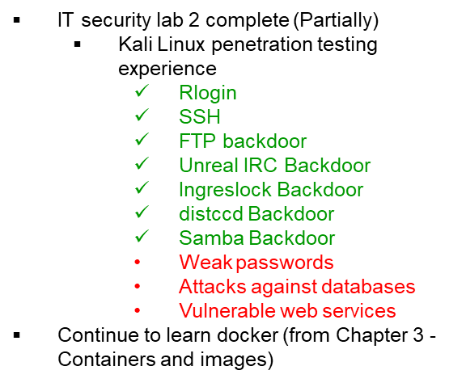

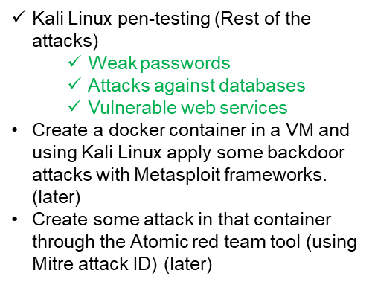
Previous Weeks Meeting Details
Week 5 Meeting (17.11.2022)
Install Infection monkey (Need AWS subscription, don’t continue anymore!!)
Start learning Docker container
https://developer.cisco.com/learning/tracks/containers/
https://learning.oreilly.com/videos/docker-fundamentals-for/9781803237428/9781803237428-video1_1/
Week 8 Meeting (08.12.2022)
Make a comparison between Kali Linux tools and Atomic Red Team
Select one to use at the end of the project
Week 9 Meeting (15.12.2022)
No update

Slide 4
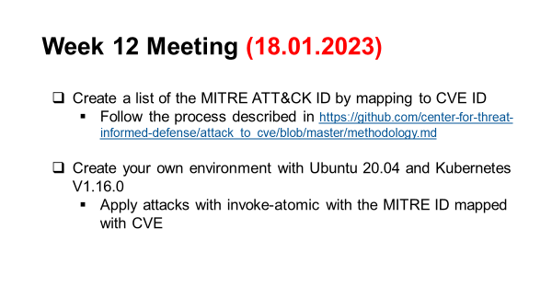
Previous Weeks Meeting Details
Week 10 Meeting (21.12.2022)
Research:
Is there a map between MITRE ID to CVE list?
In Kali Linux, is there any tool or settings to map CVE or MITRE ID?
Create an extended comparison between Atomic and Kali in MS Excel (Not done yet)
Create a list for Docker, and Kubernetes attacks:
How to attack the docker container? Which version?
What are the tools? (If required any)
What are the known vulnerabilities? (CVE, MITRE)
Create a list for Ubuntu:
Which Ubuntu version?
How to attack Ubuntu?
What are the tools? (If required any)
What are the known vulnerabilities? (CVE, MITRE)
Week 13 Meeting (25.01.2023)
Problem understanding Ubuntu OS configuration basics.
Week 11 Meeting (11.01.2023)
Research more about Vulmap.
Which type of attack can it do?
Install it in Kali Linux and have practical experience with it.
Do the lab of Docker from Devnet.
If it is installed, then try some attacks with kali and atomic by mapping to CVE/MITRE. Use the list from the previous page list. (Partially done!)

Slide 5
2. Install Kubernetes in the newly installed VM
Documentation link: https://kubernetes.io/
2 (a) Learn the basics of architecture
2 (b) Learn the meaning of the important keywords (namespaces, clusters, object, etc)
1. Create another VM with Ubuntu 20.04
Week 14 Meeting
-- 01.02.2023

Slide 6

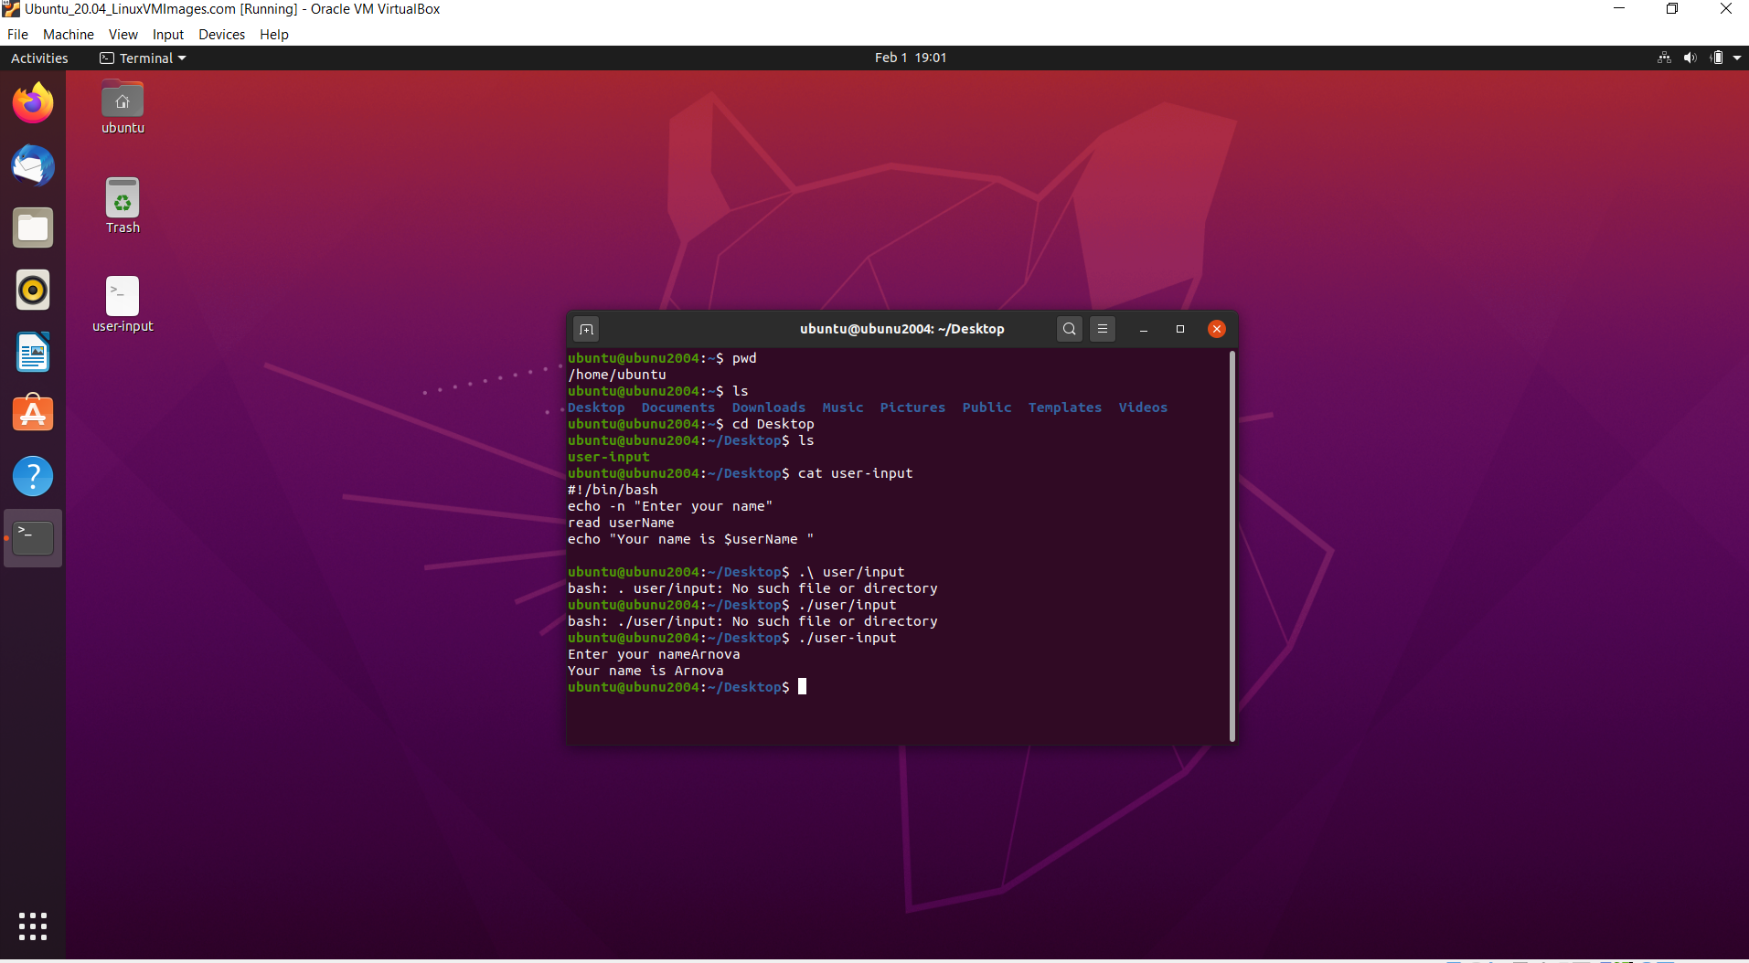
1. Create another VM with Ubuntu 20.04
Done!

Slide 7
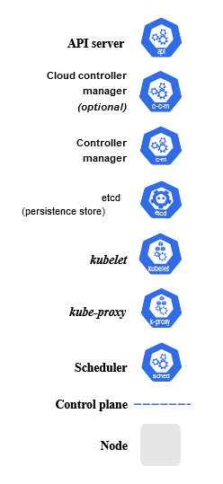
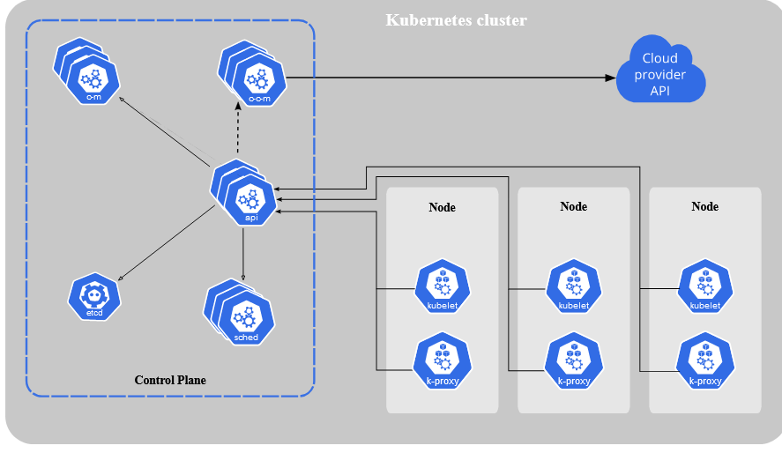
2. Install Kubernetes
2 (a) Learning the basic architecture
https://kubernetes.io/docs/concepts/overview/
Components learned-------------------------------→

Slide 8
Install Kubernetes
2 (b) Learning meanings of important terms- namespace (not required now), cluster (done), object (done), and more terms.
Before installing Kubernetes, went through the docker installation in the VM once again to understand every step clearly (like the /bin/bash command, script, shell architecture, etc)
Have not installed Kubernetes yet
Before installing Kubernetes, will go deeper into docker and Kubernetes from the documentation at first.
Will install 2-3 more containers before working with Kubernetes.

Slide 9
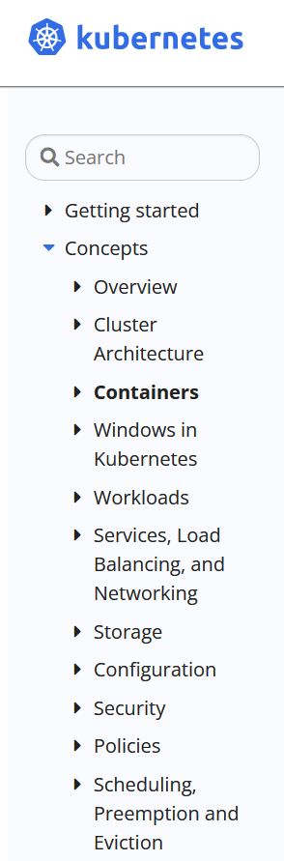

Next step - 08.02.2023 (11:00 am)
Go through this link
https://adamtheautomator.com/cri-o/
https://www.ericsson.com/en/security/security-considerations-of-open-ran
Continue learning Kubernetes and Open RAN components in parallel.
Done reading!
Next read

